Slide 1
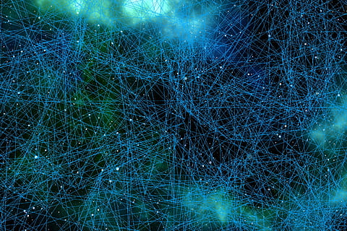
Deep Neural Networks: Generative Adversarial Networks
Jordan Driscoll, James Hall, Nathan Graham

Slide 2
Agenda
Introduction to GAN
GAN Applications
Loss Function
GAN Model Visualized
Code Overview
GAN Inputs & Outputs Visualizations
Optimizing GAN Output: Stages & Challenges
Summary

Slide 3

Introduction to GANs
Proposed by Ian Goodfellow June 2014
Goal: Generate new data using training set
2 Networks Contest with each other

Slide 4
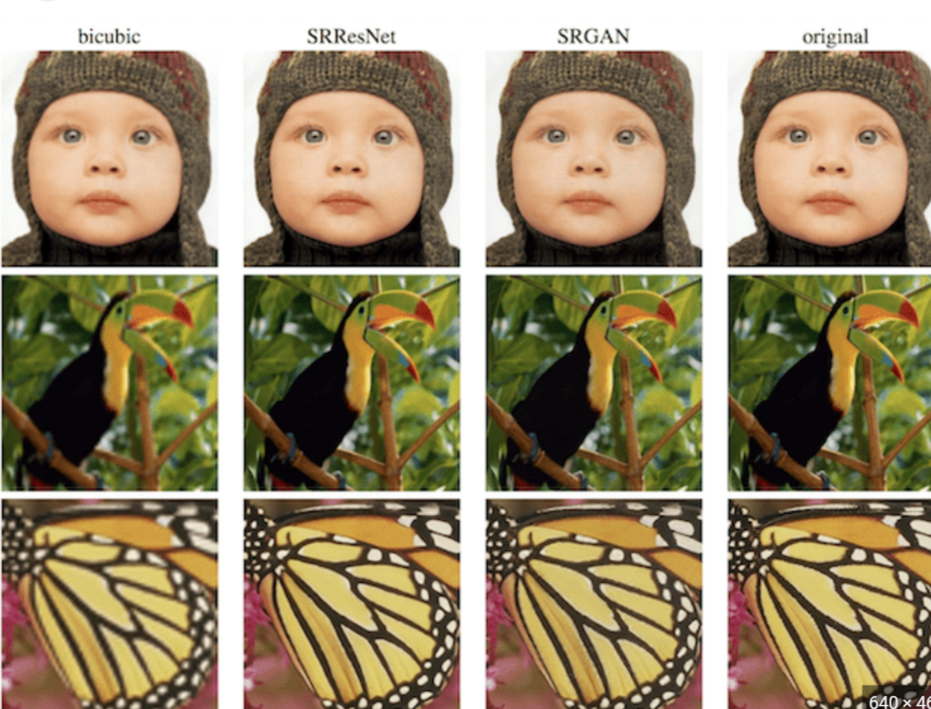
Applications of GANs I
Image Generation
Image to Image Translation
Day to Night
Artstyle modifications
Text-To-Image Synthesis
Image Enhancement, Super Resolution
Data Augmentation
Generating Realistic Samples
Video Generation
Anomaly Detection

Slide 5


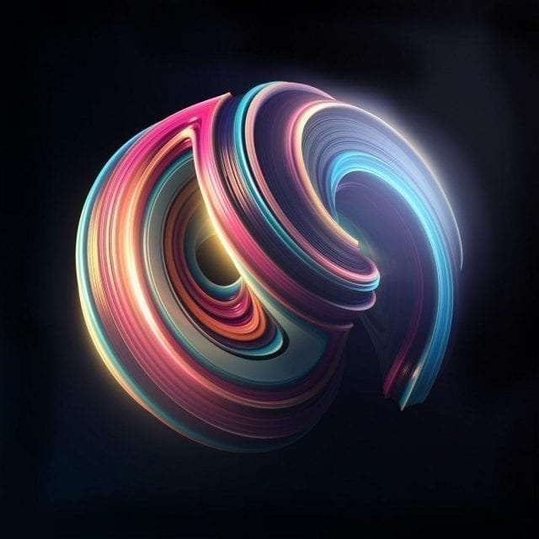
Application of GANs II
Deepfake Generation
Fashion & Apparel Design
Generating Unique Designs
Virtual Try On GANs
Game Development
Generating Realistic Characters, Objects & Environments
Speech Synthesis

Slide 6
Generative Adversarial Network
Originally: Unsupervised Learning
Partially Supervised, Supervised, & Reinforcement Learning
Generator: Map Latent-Vector to Data Space
Discriminator: Output scalar probability that image is generated
Equilibrium
Generator: Awesome Photos
Discriminator: Totally clueless

Slide 7
GAN Loss Function
Discriminator Notation
x - Image
D(x) - Scalar probability that image is fake
Binary Classification
Generator Notation
z - A latent space vector sampled from a standard normal distribution
G - Capture patterns from training data
G(z) - Maps latent vector z to data space

Slide 8
GAN Loss Function
D(G(z)) - Probability generated image is real
log: Magnifies differences of probabilities, especially when close to 0 or 1
Discriminator’s Goal
Maximize probability that its guesses are correct: log[(D(x))]
Generator’s Goal:
Minimize probability that discriminator classifies its work : log[1-(D(G(z))]
pdata(x): The data used for training
E[z ~ pz(z)] - Indicates we take the average among all noise vectors
E[x ~ pdata(x)] - Indicates we take the average among all data samples

Slide 9
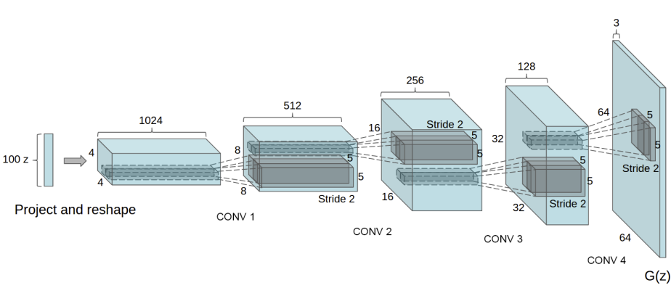
Deep Convolutional Generative Adversarial Network
Direct Extension of GAN
Convolutional & Convolutional-Transpose Layers
Leverages power of CNNs to process & visualize data
Included Architectural features:
Batch Normalization
Specific Activation Functions: ReLU
Pooling Layers

Slide 10
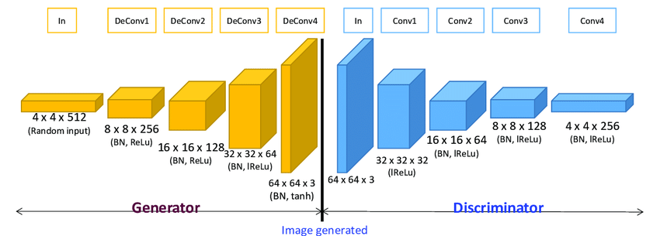
GAN Visualized

Slide 11
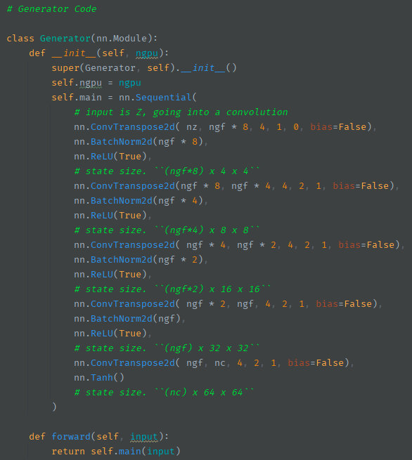
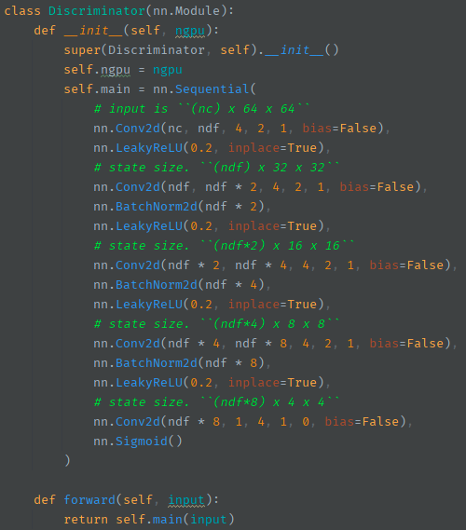
Key Distinctions
Differences:
ReLU Type
Convolution Type
Output Function Type
Reverse

Slide 12
Generator
Responsible for creating images
Never sees sample images
Improves based on discriminator
Starts with random noise vector, z
ConvTranspose2d() to upscale
BatchNorm2d() to normalize
ReLU() to map complexities
Repeat
Ends with Tanh()
Squashes pixel values to intensity range (-1, 1)
Notes:
Generator uses Tanh() for its output function because it ranges symmetrically around 0 from -1 to 1, which is useful for image generators because pixel values can have both positive and negative values, meaning that using tanh() makes it easier for the network to recognize different pixels and intensities and thus create better looking images.

Slide 13
Discriminator
Responsible for making probability of image being real
Sees Generator’s output and sample images
‘Improves’ by picking the generated image
Starts with generated image, x
Conv2d() to downscale
BatchNorm2d() to normalize
LeakyReLU() to map complexities and avoid neuron death
LeakyReLU allows for negative input values
Ends with Sigmoid()
Squashes pixel intensity to 0 - 1 values
Notes:
Sigmoid() has a range of 0,1 which is perfect for the discriminator because since it is only identifying if an image is Real or Fake, it only needs to range from 0 to 1, (0 being fake, 1 being real).
LeakyReLU is important because the input image can have negative values, and if regular ReLU was used, it would convert all the negatives into zeros and thus ruin the input image’s values and possibly lead to a misclassification, or neuron death
Neuron death: When a large number of neurons become inactive (output zero), it can cause corresponding weights to never update, thus killing those neurons.

Slide 14
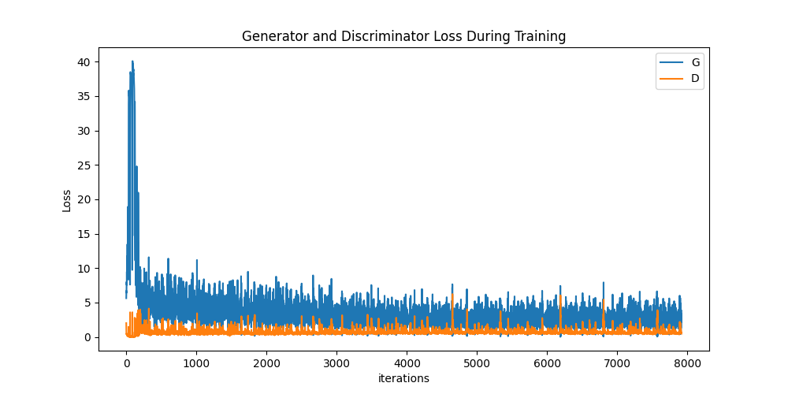
Original Tutorial Sample - Celebrity Faces (CelebA)

Slide 15
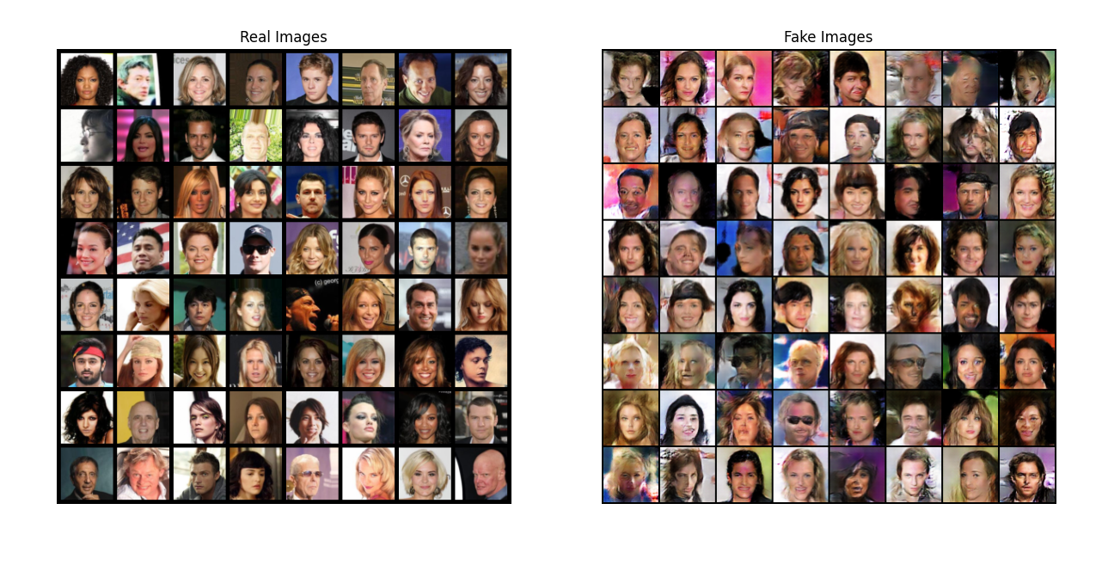
Dataset size = 202,599 | results from epoch = 5
This took 23 min to train?

Slide 16
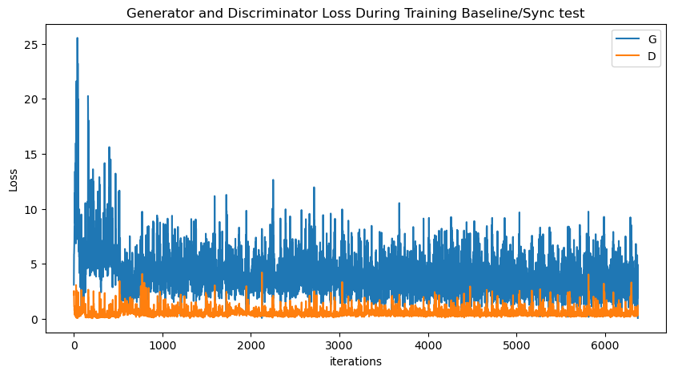
Wiki-Art Dataset | 51,000 pictures

Slide 17
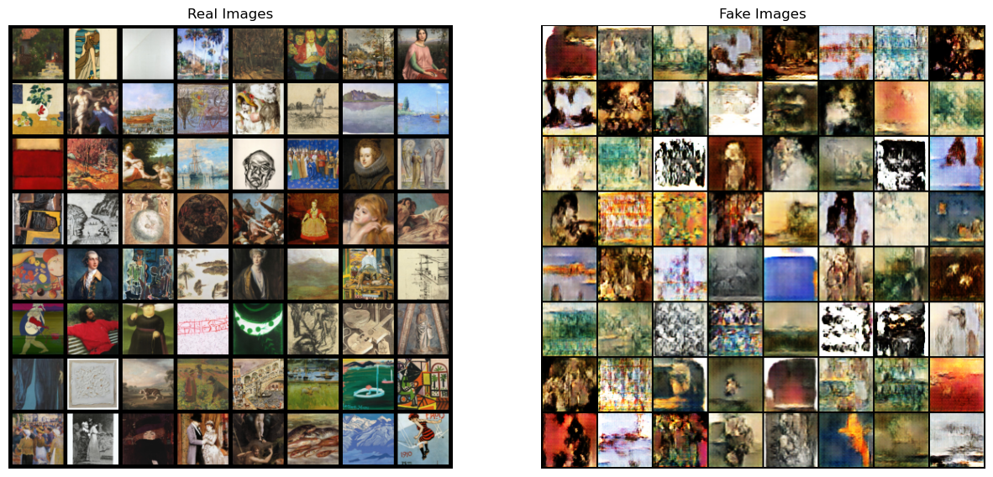

Slide 18
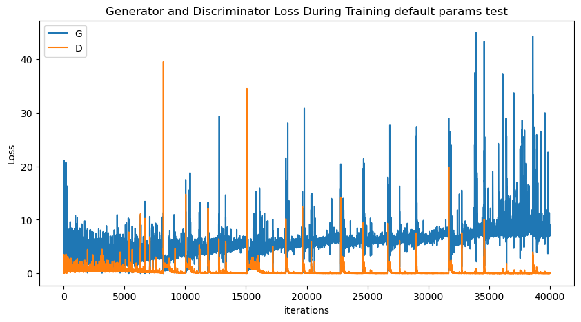
Impressionist Landscapes Dataset

Slide 19
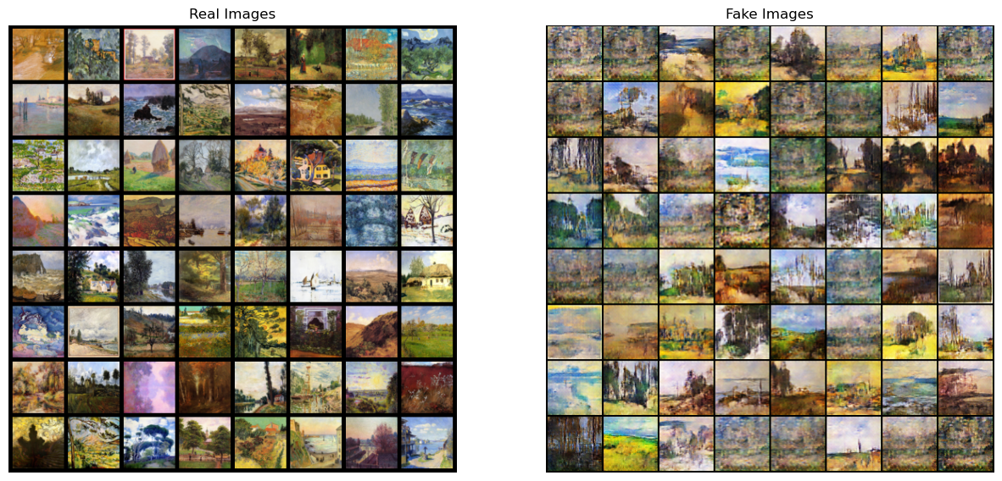

Slide 20
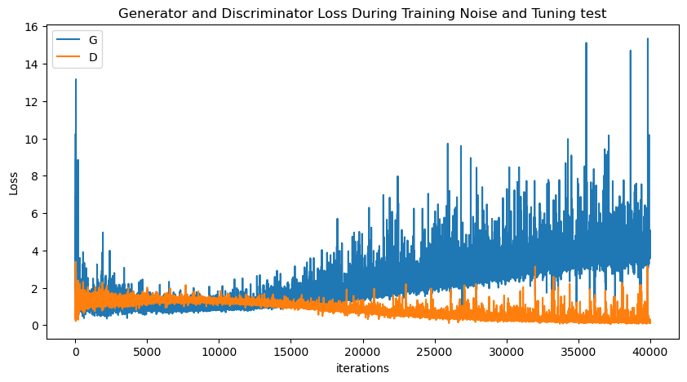
Adding Noise to Discriminator

Slide 21
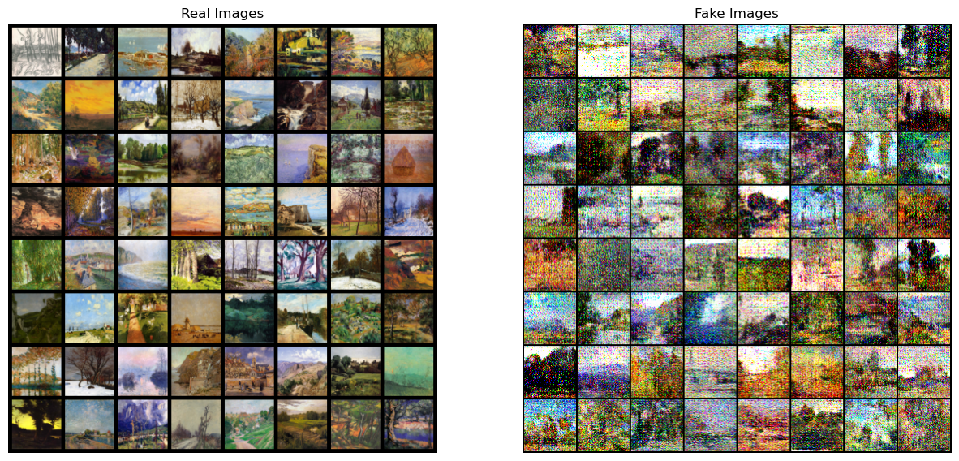

Slide 22


Slide 23
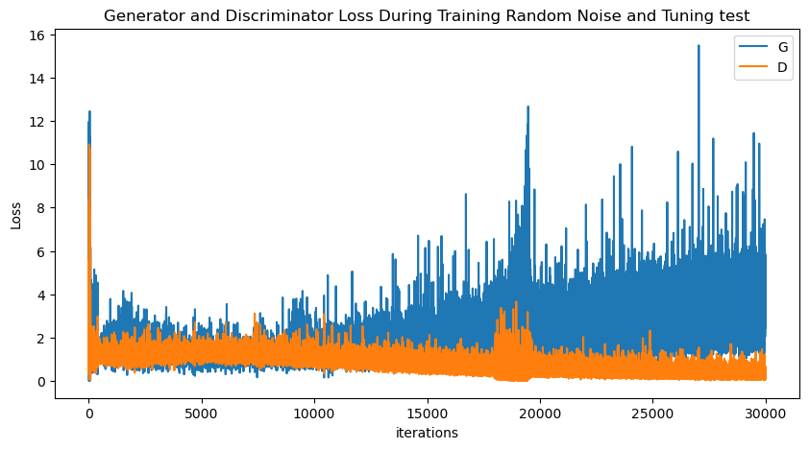
Adding Noise based on Probability (50%)

Slide 24
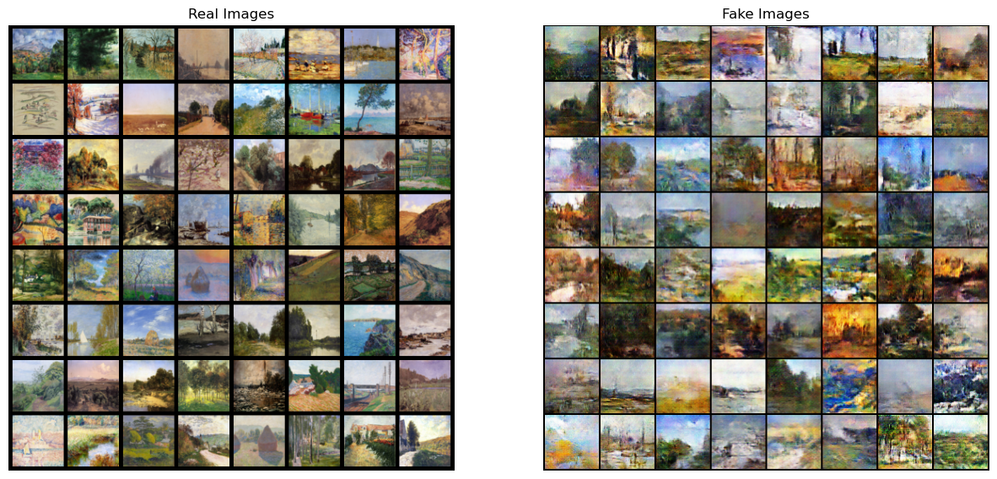

Slide 26
Project Summary
The purpose of this implementation of DCGAN is to expand datasets.
Reduced dataset scope due to limited hardware resources.
Narrowing scope of database to only landscapes was effective.
Found effective way to “slow down” the Discriminator and discovered troubleshooting methodologies.
Acceptable results obtained despite using “lesser” hardware.
Final results: Epochs: 750, Dataset size: 5000, Time: 9.5 Hours
Suggestion:
Save Model every ~100 epochs or every hour of compute time

Slide 27
Sources
Nathan Inkawhich - DCGAN Tutorial:
https://pytorch.org/tutorials/beginner/dcgan_faces_tutorial.html
WikiArt Dataset:
https://paperswithcode.com/dataset/wikiart
Impressionist Landscapes Dataset:
https://www.kaggle.com/datasets/robgonsalves/impressionistlandscapespaintings

Slide 28
Questions?
Thanks for your time!
In case you missed it:
Title: Deep Neural Networks: Generative Adversarial Networks
Team: Jordan Driscoll, James Hall, Nathan Graham

